Slide 1
Selection Structures

Slide 2
A Programming Example
The Problem:
Write a program that takes as input a given length expressed in feet and inches. It then converts and outputs the length in centimetres.

Slide 3
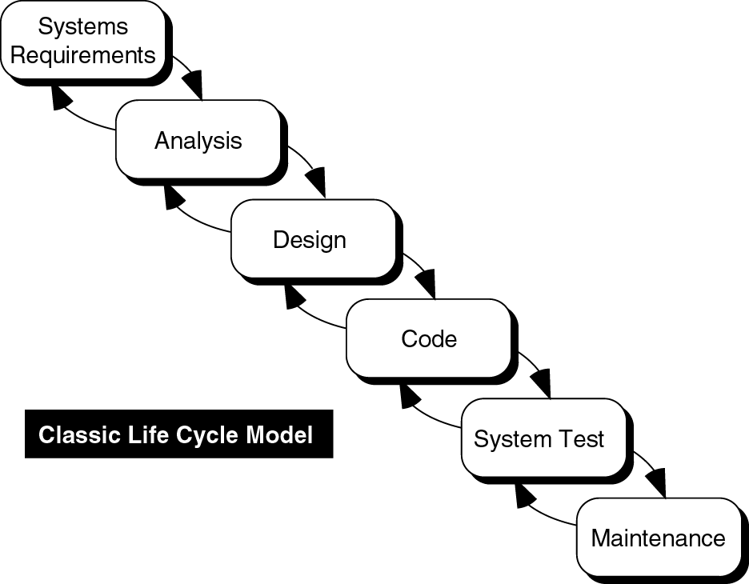
System Development Life Cycle
Problem
Problem Specification
General Solution
Algorithm
Program
Test

Slide 4
The Problem Specification
Input: Length in feet and inches
The program will need to find the equivalent length in centimetres
One inch is equal to 2.54 centimetres
Output: Equivalent length in centimetres

Slide 5
Analysing the Problem
The first thing the program needs to do is convert the length given in feet and inches to inches only.
Next, use the conversion formula
1 inch = 2.54 centimetres
to find the equivalent length in centimetres.

Slide 6
Analysing the Problem
To convert the length from feet and inches to inches, multiply the number of feet by 12, as 1 foot is equal to 12 inches, and add the given inches.
Then apply the conversion formula, that is, 1 inch = 2.54 centimetres, to find the length in centimetres.

Slide 7
A General Solution
  get the length in feet and inches
  convert the length into total inches
  convert total inches into centimetres
  output centimetres

Slide 8
Program Design
The algorithm:
1. Prompt the user for the input
2. Get the data
3. Find the length in inches
4. Output the length in inches
5. Convert the length to centimetres
6. Output the length in centimetres

Slide 9
Program Implementation
The program will begin with comments that document its purpose and functionality.
The program will use input statements to get data into the program and output statements to print the results.

Slide 10
Program Implementation
The data will be entered from the keyboard and the output will be displayed on the screen, so the program must include the header file iostream.
The first statement of the program, after the comments as described above, will be the preprocessor directive to include this header file.

Slide 11
Program Implementation
Variables
  int feet; // holds given feet
  int inches; // holds given inches
  int totalInches; // holds total inches
  double cm; // holds length in cm
Named Constants
  const double cmPerInch = 2.54;
  const int inchesPerFoot = 12;

Slide 12
Program Implementation
The body of the function main has the following form
int main ()
{
declare variables
statements
return 0;
}

Slide 13
Writing the Complete Program
Begin the program with comments for documentation.
Include header files, if any are used in the program.
Declare named constants, if any.
Write the definition of the main.

Slide 14
Writing the Complete Program
// Program Description: Converts a given length
// from feet and inches to cm
#include <iostream>
using namespace std;
const double cmPerInch = 2.54;
const int inchesPerFoot = 12;
int main()
{
int feet, inches, totalInches;
double cm;
cout << "Please enter length in feet and inches: ";
cin >> feet >> inches;
totalInches = inches + feet*inchesPerFoot;
cout << "\nThe length in inches is: " << totalInches << endl;
cm = totalInches * cmPerInch;
cout << "The length in centimetres is: " << cm << endl;
return 0;
}

Slide 15
Flowchart of a Simple Program
//Calculates the surface area of a cube
#include <iostream>
using namespace std;
int main()
{
int area, length;
cout << "Enter length of side in cm:";
cin >> length;
area = length * length * 6;
cout << "Area is " << area << " sq cm\n";
return 0;
}
Get length
of side
Calculate area
Display area

Slide 16
Program Flow of Execution
The statements in the previous program are executed in sequence.
The statements are executed one after the other from the top to the bottom of the program.
This is called consecutive or sequential code execution.
Top of program
Process 1
Process 2
Process n
Bottom of program

Slide 17
Program Flow of Execution
The three main ways the execution of the statements in a program may progress are:
  Consecutive or sequential execution
  Choice (or selection)
  Repetition (or iteration)

Slide 18
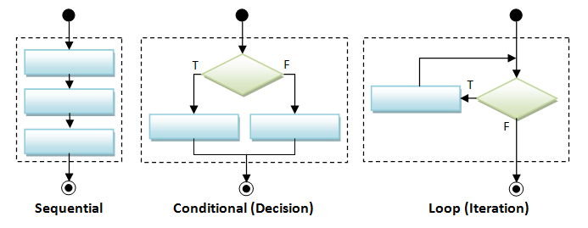
Program Flow Control Constructs
Diagram from https://www3.ntu.edu.sg/home/ehchua/programming/cpp/cp1_Basics.html

Slide 19
The Conditional Statement Flowchart
Previous Statement
No
Is condition
true?
Yes
Statement or block of code
Next Statement

Slide 20
The Conditional Statement Pseudocode
BEGIN
•••
IF condition THEN
statement
ENDIF
•••
END
Determines whether statement (or block of code) is executed by evaluating the condition.
If the condition is true (non-zero), statement (or block of code) is executed.
executed if
condition is true

Slide 21
Like when we use if in current language
condition
IF it’s raining THEN
I’ll take my umbrella
ENDIF
If it is raining the condition is true and as a consequence I’ll take my umbrella
executed if
condition is true

Slide 22
The Conditional Statement in C++
if (logical expression)
statement
As with any C++ statement the whitespace is not required, so
if (logical expression) statement
is also valid.
Note there is no ; after the )

Slide 23
The condition in an if Statement
The logical expression can be created using
  relational expressions, logical operations or a combination of these
  and
  may also contain arithmetic expressions
  Example:
  if (!(a*b > a/3) && (a <= 9)) ...

Slide 24
Relational Operators
Operator | Meaning | Example
< | less than | 3 < 10
<= | less than or equal to | width <= 5
> | greater than | degrees > 43.5
>= | greater than or equal to | age >= 5
== | equal to | mark == 85
!= | not equal to | distance != 12.3
All six relational operators are binary

Slide 25
Relational Expressions
Relational expressions have logical values:
  false (e.g. 3 == 5) or,
  true (e.g. 3 < 5)
If age=7, the value of age >= 5 is true
If age=2 , the value of age >= 5 is false
Although a boolean value may be stored as 0 or 1, do not think of these values as anything other than true or false.

Slide 26
Relational Operators Precedence
Operator | Precedence
< <= > >= | higher
== != | lower

Slide 27
An example
What is the output of this program?
Answer:
#include <iostream>
using namespace std;
int main()
{
int a = 5, b = -3;
cout << a << " < " << b
<< " is " << (a < b) << endl;
cout << a << " == " << b
<< " is " << (a == b) << endl;
cout << a << " != " << b
<< " is " << (a != b) << endl;
cout << a << " >= " << b
<< " is " << (a >= b) << endl;
return 0;
}
5 < -3 is 1
5 == -3 is 0
5 != -3 is 1
5 >= -3 is 1

Slide 28
Wait …. Wait …. Wait
Didn't we just say not to consider boolean values as 0 or 1?
Unfortunately C++ cannot print out (or enter) boolean values.
So, avoid doing so in programs.
Use if tests on both input and output.

Slide 29
Wait …. Wait …. Wait
int a = 5, b = -3;
bool comp;
comp = (a>b);
if (comp)
cout << "true\n";

Slide 30
Wait …. Wait …. Wait
bool under20=false;
char ch;
cout << "Are you aged under 20? ";
cin << ch;
if (ch == 'Y')
under20 = true;
But what if a lower case y were entered?
We would need to check for that as well.

Slide 31
Logical Operators
Logical values can also be combined using logical operators.
One of these has already been encountered:
  not with symbol !
  complements the meaning
  !true is false, !false is true
  !(age<23) is the same as age>=23

Slide 32
Logical Operators
The other two operators are binary
  logical and with the symbol &&
  logical or with the symbol ||
  Such operations are best explained using a truth table
! has higher priority

Slide 33
Logical Operators
And – the value of expr1 && expr2
expr2
true
false
true
true
false
expr1
false
false
false

Slide 34
Logical Operators
Or – the value of expr1 || expr2
expr2
true
false
true
true
true
expr1
false
true
false

Slide 35
Logical Operators
Note that
  !(expr1 || expr2) is the same as
      !expr1 && !expr2
  !(expr1 && expr2) is the same as
  (!expr1) || (!expr2)

Slide 36
Operator Precedence
Highest
! + - logical not, unary +, unary –
* / % multiplication, division, mod
+ - addition, subtraction
< <= >= > relational inequality
== != equal, not equal
&& logical and
|| logical or
= assignment
lowest

Slide 37
Examples
Given the following values for boolean variables X, Y, and Z, evaluate the logical expressions and answer T if the result is True and F if the result is False.
X = true, Y = false, Z = false
!(Y || Z) || X
Z && X && Y
!Y || (Z || !X)
Z || (X && (Y || Z) )
5 || !X && Z
Answer:
T
F
T
F
T

Slide 38
Example
Write a C++ program that reads a number from standard input and prints it if the number is even.

Slide 39
Example
// Reads in a number and prints it
// out if even
#include <iostream>
using namespace std;
int main()
{
return 0;
}
Reads in a number and prints it
out if even:
BEGIN
output “Enter an integer:”
read in number
IF number is even THEN
printout the number
ENDIF
END

Slide 40
Example
// Reads in a number and prints it
// out if even
#include <iostream>
using namespace std;
int main()
{
int number;
cout << "Enter an integer: ";
cin >> number;
return 0;
}
Reads in a number and prints it
out if even:
BEGIN
output “Enter an integer:”
read in number
IF number is even THEN
printout the number
ENDIF
END

Slide 41
Example
// Reads in a number and prints it
// out if even
#include <iostream>
using namespace std;
int main()
{
int number;
cout << "Enter an integer: ";
cin >> number;
if (number % 2 == 0) cout << number << endl;
return 0;
}
Reads in a number and prints it
out if even:
BEGIN
output “Enter an integer:”
read in number
IF number is even THEN
printout the number
ENDIF
END
LOOK no semicolon here!

Slide 42


Example
// Reads in a number and prints it
// out if even
#include <iostream>
using namespace std;
int main()
{
int number;
cout << "Enter an integer: ";
cin >> number;
if (number % 2 == 0); cout << number << endl;
return 0;
}
What happens if by mistake I put a ; after
(number % 2 == 0)?

Slide 43
What is the problem?
if (number % 2 == 0);
is equivalent to:
if (number % 2 == 0)
; //empty statement
So the statement following ';' which is
cout << number << endl;
is always executed

Slide 44
Example
// Reads in a number and prints it
// out if even
#include <iostream>
using namespace std;
int main()
{
int number;
cout << "Enter an integer: ";
cin >> number;
if (number % 2 == 0)
cout << number << endl;
return 0;
}
LOOK it’s ==
not =

Slide 45
Example
By mistake x=5 was typed in instead of x==5, what is the output if I enter 5?
// A common mistake
// should be x==5 instead of x=5
#include <iostream>
using namespace std;
int main()
{
int x;
cin >> x;
if (x = 5) cout << "x is 5";
return 0;
}
Answer: x is 5

Slide 46
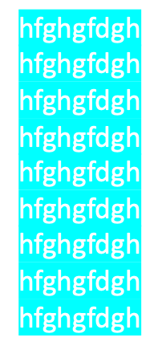

Example
Modify the example program to output the following extra line before the line printing out the even number: I’m not odd
I’m not odd!!

Slide 47
Example
This is a compound statement – several statements inside a {} pair.
No need for following ;
// Reads in a number and prints it
// out if even
#include <iostream>
using namespace std;
int main()
{
int number;
cout << "Enter an integer: ";
cin >> number;
if (number % 2 == 0)
{
cout << "I’m not odd!!"; cout << number << endl;
}
return 0;
}
Reads in a number and prints it
out if even
BEGIN
output "Enter an integer:"
read in number
IF number is even THEN
printout "I’m not odd!!"
printout the number
ENDIF
END

Slide 48
The if-else Statement Pseudocode
IF condition THEN
statement 1 executed if condition is true
ELSE
statement 2 executed if condition is false
ENDIF

Slide 49
The if-else Statement Flowchart
Previous Statement
LOOK this is the else part of the if-else statement
No
Is condition
true?
Yes
Statement 1 or block of code 1
Statement 2 or block of code 2
Next Statement

Slide 50
Notes on else
else can only occur after an if statement
else is only executed when the if’s statement or block does not execute
the whole if-else structure is considered one statement

Slide 51

Example
Make no mistake
no semicolon here!
// Reads in a number and finds
// if the number is even or odd
#include <iostream>
using namespace std;
int main()
{
int num;
cout << "Enter an integer: ";
cin >> num;
if (num % 2 == 0)
cout << num << " is even\n";
else
cout << num << " is odd\n";
return 0;
}
Reads in a number and finds
if it is even or odd
BEGIN
output "Enter an integer:"
read in number
IF number is even THEN
printout number is even
ELSE
printout number is odd
ENDIF
END

Slide 52
Example
// Reads in a number and finds
// if the number is even or odd
#include <iostream>
using namespace std;
int main()
{
int num;
cout << "Enter an integer: ";
cin >> num;
if (num % 2 == 0)
cout << num << " is even\n";
else
cout << num << " is odd\n";
return 0;
}
We can swap these two statements
if we use the condition:
num % 2 != 0
instead of:
num % 2 == 0

Slide 53
Example
// Reads in a number and finds
// if the number is even or odd
#include <iostream>
using namespace std;
int main()
{
int num;
cout << "Enter an integer: ";
cin >> num;
if (num % 2 != 0)
cout << num << " is odd\n";
else
cout << num << " is even\n";
return 0;
}
Reversed meaning of the condition

Slide 54
More Complements
> is the complement of <=
< is the complement of >=
!expr is the complement of expr

Slide 55
Cascaded and Nested if Statements
if and if-else statements can contain simple or compound statements.
Any valid C++ statement can be used including if and if-else statements.
if and if-else statements can be included within the if and/or else part of other
if/if-else statements.

Slide 56
Cascaded if Statements
if (expression 1)
statement 1;
else
if (expression 2)
statement 2;
else
statement 3;
NOTE: else statements are
always paired with the
closest unpaired if statement
This else is paired with this if

Slide 57
Cascaded if Statements
As white space is ignored, cascaded if statements are generally implemented as follows:
if (expression 1)
statement 1;
else if (expression 2)
statement 2;
else
statement 3;
"sieve"
or
"filter"

Slide 58
Example
// Converts score to grade
/* This program reads a test
score, calculates the letter grade
based on the absolute scale, and
prints it.*/
#include <iostream>
using namespace std;
int main (void)
{
int score;
char grade;

Slide 59
Example
cout << "\nEnter the test score (0-100): ";
cin >> score;
if (score >= 90)
grade = 'A';
else if (score >= 80)
grade = 'B';
else if (score >= 70)
grade = 'C';
else if (score >= 60)
grade = 'D';
else
grade = 'F';

Slide 60
Example
cout << "The grade is: "
<< grade << endl;
return 0;
}

Slide 61
Try this one
What is the output if
letter is equal to ‘b’
letter is equal to ‘z’
letter is equal to ‘A’
letter is equal to ‘X’
#include <iostream>
using namespace std;
int main()
{
char letter;
cout << "Enter a character: ";
cin >> letter;
if (letter >= 'a')
cout << "S1";
else if (letter <= 'z')
cout << "S2";
else if (letter >= 'A')
cout << "S3";
else if (letter <= 'Z')
cout << "S4";
return 0;
}

Slide 62
Nested if Statements
statement 1:
if (distance > 1000)
    cout << "long distance ";
statement 2:
if (time < 2)
statement 1
else
  cout << "not quick";

Slide 63
Nested if Statements
Is this statement 2?
Answer: NO
This else is paired with
this if
if (time < 2)
if (distance > 1000)
cout << "long distance ";
else
cout << "not quick";

Slide 64
Nested if Statements
This is statement 2:
if (time < 2)
{
if (distance > 1000)
cout << "long distance";
}
else
cout << "not quick";

Slide 65
The Dangling else Problem
This example illustrated a common error known as the “dangling else”.
This problem occurs when there is no matching else for every if.
Remember that the C++ compiler always pairs an else to the most recent if in the current block.

Slide 66
Conditional Expressions
Conditional expressions provide a alternative way of expressing simple
if-else statements
Conditional expressions use the conditional operator ? :

Slide 67
Conditional Expressions
The syntax of a conditional expression is:
expression1 ? expression2:expression3
Note: the conditional operator is a ternary operator (i.e. it takes 3 operands)
condition
executed if
condition is true
executed if
condition is false

Slide 68
Conditional Expressions
How do we interpret this statement?
If the value of expression1 is non-zero (true) expression2 is printed; otherwise, expression3 is printed
The statement either prints the value of expression2 or of expression3
cout << (expression1 ? expression2 : expression3);

Slide 69
Conditional Expressions
The meaning of a conditional expression is lost in a jumble of operators, without easily being able to follow the logic of the if/else process.
DO NOT USE

Slide 70
The switch Statement
We have seen that cascaded if statements are used when one instruction (or set of instructions) must be selected from many possible alternatives
  the sieve concept
The switch statement provides a convenient alternative for cases where the value of an integer expression is compared to a specific value (not a range of values)

Slide 71
The switch Statement
The syntax of a switch statement:
switch (expression)
{
case const_expr1:
statement1;
break;
case const_expr2:
statement2;
break;
case const_expr3:
statement3;
break;
default:
statement;
}
Expression's value must be integer
A constant expression
Causes exit from switch statement
Execution only gets here if none of the constant expressions equals the value of the expression

Slide 72
Example
LOOK no break here!
switch (printFlag)
{
case 1:
case 3:
cout << "Good Day\n";
cout << "Odds have it!\n";
break;
case 2:
case 4:
cout << "Good Day\n";
cout << "Evens have it!\n";
break;
default:
cout << "Good Day, I'm confused!\n";
cout << "Bye!\n";
}

Slide 73
Example
switch (printFlag)
{
case 1:
case 3:
cout << "Good Day\n";
cout << "Odds have it!\n";
break;
case 2:
case 4:
cout << "Good Day\n";
cout << "Evens have it!\n";
break;
default:
cout << "Good Day, I'm confused!\n";
cout << "Bye!\n";
}
  The break statement
  causes an immediate
  exit from the switch
  statement

Slide 74
Example
What is the output of
this switch if printFlag=1?
Answer:
switch (printFlag)
{
case 1:
case 3:
cout << "Good Day\n";
cout << "Odds have it!\n";
break;
case 2:
case 4:
cout << "Good Day\n";
cout << "Evens have it!\n";
break;
default:
cout << "Good Day, I'm confused!\n";
cout << "Bye!\n";
}
Good Day
Odds have it!

Slide 75
Example
What is the output of
this switch if printFlag=2?
Answer:
switch (printFlag)
{
case 1:
case 3:
cout << "Good Day\n";
cout << "Odds have it!\n";
break;
case 2:
case 4:
cout << "Good Day\n";
cout << "Evens have it!\n";
break;
default:
cout << "Good Day, I'm confused!\n";
cout << "Bye!\n";
}
Good Day
Evens have it!

Slide 76
Example
What is the output of
this switch if printFlag=3?
Answer:
switch (printFlag)
{
case 1:
case 3:
cout << "Good Day\n";
cout << "Odds have it!\n";
break;
case 2:
case 4:
cout << "Good Day\n";
cout << "Evens have it!\n";
break;
default:
cout << "Good Day, I'm confused!\n";
cout << "Bye!\n";
}
Good Day
Odds have it!

Slide 77
Example
What is the output of
this switch if printFlag=4?
Answer:
switch (printFlag)
{
case 1:
case 3:
cout << "Good Day\n";
cout << "Odds have it!\n";
break;
case 2:
case 4:
cout << "Good Day\n";
cout << "Evens have it!\n";
break;
default:
cout << "Good Day, I'm confused!\n";
cout << "Bye!\n";
}
Good Day
Evens have it!

Slide 78
Example
What is the output of
this switch if printFlag=5?
Answer:
switch (printFlag)
{
case 1:
case 3:
cout << "Good Day\n";
cout << "Odds have it!\n";
break;
case 2:
case 4:
cout << "Good Day\n";
cout << "Evens have it!\n";
break;
default:
cout << "Good Day, I'm confused!\n";
cout << "Bye!\n";
}
Good Day, I'm confused!
Bye!

Slide 79
switch structure summary
switch, case, break, and default are reserved words.
In a switch structure, the expression is evaluated first.
The value of the expression is used to determine which case statement is selected for execution.

Slide 80
switch structure summary
One or more statements may follow a case label.
Braces are not needed to turn multiple statements into a single compound case statement.
The break statement may or may not appear after each statement.

Slide 81
switch structure summary
When a case statement is selected, code will execute until a break statement is found or the end of the switch structure is reached.
If the value of the expression does not match any of the case values, the statements following the default label execute.
If there is no default label, and if the value of the expression does not match any of the case values, the entire switch statement is skipped.

Slide 82
switch statement Rules
The expression within the switch must evaluate to an integer.
A constant expression must follow the case label (i.e. cannot use a variable).
case labels must have different values.
Different case statements may be followed by the same statements.
The default label is not compulsory.
There can be at most one default label.

Slide 83
So…
switch (x)
{
  case 1: cout << "One" << endl;
  case 2: cout << "Two" << endl;
  case 3: cout << "Three" << endl;
}
What is the output of this switch statement if x=1?
Answer:
x=2?
If x has the value 1, the output is:
  One
  Two
  Three
If x has the value 2, the output is:
  Two
  Three

Slide 84
Example
Let's write ourselves a little integer desk calculator.
The input will be
a left operand
an operator
a right operand
The output will be the result of the operation.

